Slide 1
PMCA502L – JAVA Programming
GUI and JDBC
GUI Programming using JavaFX - Exploring Events - Controls and JavaFX Menus - Accessing Databases using JDBC Connectivity - Prepared Statement

Slide 2
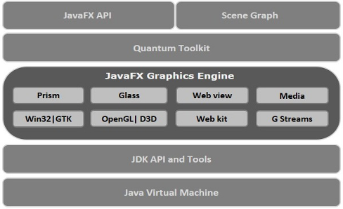
JFX - Introduction
JavaFX is a Java library used to build Rich Internet Applications. The applications written using this library can run consistently across multiple platforms. The applications developed using JavaFX can run on various devices such as Desktop Computers, Mobile Phones, TVs, Tablets, etc.
JavaFX Architecture

Slide 3
JFX - Introduction
JavaFX provides a complete API with a rich set of classes and interfaces to build GUI applications with rich graphics. The important packages of this API are −
javafx.animation − Contains classes to add transition based animations such as fill, fade, rotate, scale and translation, to the JavaFX nodes.
javafx.application − Contains a set of classes responsible for the JavaFX application life cycle.
javafx.css − Contains classes to add CSS–like styling to JavaFX GUI applications.
javafx.event − Contains classes and interfaces to deliver and handle JavaFX events.
javafx.geometry − Contains classes to define 2D objects and perform operations on them.
javafx.stage − This package holds the top level container classes for JavaFX application.
javafx.scene − This package provides classes and interfaces to support the scene graph. In addition, it also provides sub-packages such as canvas, chart, control, effect, image, input, layout, media, paint, shape, text, transform, web, etc. There are several components that support this rich API of JavaFX.

Slide 4
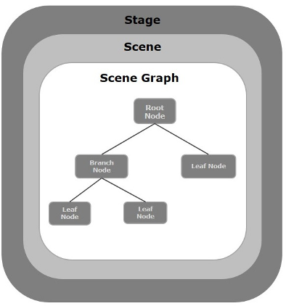
JAVAFX Application Structure
A stage (a window) contains all the objects of a JavaFX application
A scene represents the physical contents of a JavaFX application.
A scene graph is a tree-like data structure (hierarchical) representing the contents of a scene.
In contrast, a node is a visual/graphical object of a scene graph.
Geometrical (Graphical) objects (2D and 3D) such as − Circle, Rectangle, Polygon, etc.
UI Controls such as − Button, Checkbox, Choice Box, Text Area, etc.
Containers (Layout Panes) such as Border Pane, Grid Pane, Stack Pane, Flow Pane, etc.
Media elements such as Audio, Video and Image Objects.

Slide 5
JFX - Introduction
Stage in a JavaFX application is similar to the Frame in a Swing Application. It acts like a container for all the JavaFX objects.
Scene actually holds all the physical contents (nodes) of a JavaFX application. Javafx.scene.Scene class provides all the methods to deal with a scene object. Creating scene is necessary in order to visualize the contents on the stage.
Scene Graph can be seen as the collection of various nodes. A node is the element which is visualized on the stage. It can be any button, text box, layout, image, radio button, check box, etc.

Slide 6
JFX - METHODS
Need to import javafx.application.Application class in every JavaFX application. This provides the following life cycle methods for JavaFX application.
Init() – auto calling
Start(Scene) – can override
Stop() – implicit
Launch(string[])

Slide 7
Layouts
Layout defines the way in which the components are to be seen on the stage. It basically organizes the scene-graph nodes. We have several built-in layout panes in JavaFX that are HBox, VBox, StackPane, GridPane, FlowBox, AnchorPane, etc.
javafx.scene.layout - class

Slide 8
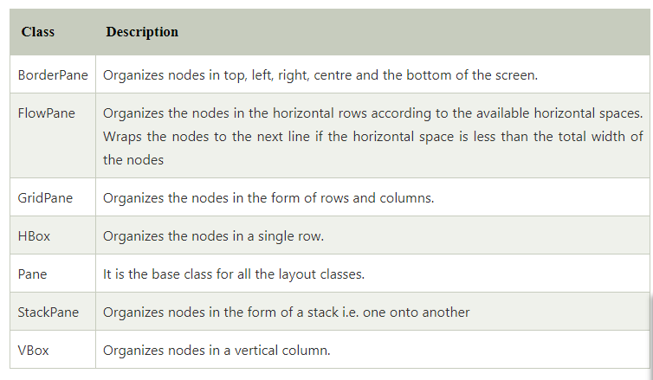
Layout Types

Slide 9
Panes – Grid Pane
Creating a Grid Pane:
GridPane gp = new GridPane();
Setting the padding:
gp.setPadding(new Insets(lt pad, rt pad, toppad, botpad)
(like Box Margin of the display area)
Setting the vertical and horizontal gaps between the columns:
gp.setVgap(int), gpsetHgap(int)
(gaps between every coloumns and rows respectively)
Adding nodes in the grid
gp.addRow(row, child[,child..])
gp.add(child, column, row)

Slide 10
Scene and Stage
Creating scene
Scene s = new Scene(Pane, vertical size, horizontal size)
Setting title to Stage
Stage.setTitle(“First SFX Programm”);
Adding Scene to stage
Stage.setScene(s);
Make Scene to visible);
Stage.show();

Slide 11
JavaFX Page Creation – Hierarchy
Create necessary controls and events
Create pane, set padding and gaps.
Add controls to pane
Create scene with pane
Attach the scene to stage, set title to stage and show the stage
Controls
Events
Pane
Scene
Stage
Show

Slide 12
SFX controls - creation
Controls – Label, Button, TextField, PasswordField, CheckBox and RadioButton
Control process creation:
Label t = new Label(“Name”);
TextField tf = new TextField();
PasswordField pf = new PasswordField();
Button b = new Button(“Click”);
CheckBox cb = new CheckBox(“Java”);
RadioButton male= new RadioButton(“Male”);
RadioButton female= new RadioButton(“Female”);
ToggleGroup gender = new ToggleGroup(); //creating as group
male.setToggleGroup(gender); //Adding radio button to a group
Female.setToggleGroup(gender);

Slide 13
User Control - Properties
javafx.scene.control.Label class represents label control. As the name suggests, the label is the component that is used to place any text information on the screen. It is mainly used to describe the purpose of the other components to the user. Constructors:
Label(): creates an empty Label
Label(String text): creates Label with the supplied text
Label L1 = new Label(“Name”);
Label L2 = new Label();
L2.setText(“Age”);
String s = L1.getText();

Slide 14
TextField
package name -javafx.scene.control.TextField
Consturctor
TextField t1 = new TextField(); //default constructor
TextField t2 = new TextField(“Java Program”);// Parameterized Constructor
Methods
String s = t1.getText(); //get the value
t2.setText(“New Value”); // set the value
t2.setEditable(false);//disable the text box
t2.setEditable(true); //activate the text box

Slide 15
Password
package name -javafx.scene.control.Password
Consturctor
Password p1 = new Password (); //default constructor
Password t2 = new Password (“Java Program”);// Parameterized Constructor
Methods
String s = p1.getText(); //get the value
p2.setText(“New Value”); // set the value

Slide 16
RadioButton
package name -javafx.scene.control.RadioButton
Consturctor
RadioButton r1 = new RadioButton(“Value1”); //Parameterized constructor
RadioButton r2 = new RadioButton(“value2”);// Parameterized Constructor
Methods
String s = r1.getText(); //get the value
r2.setText(“New Value”); // set the value
r1.isSelected(); // returns true if it is selected
Grouping:
package name -javafx.scene.control.ToggleGroup
ToggleGroup g1 = new ToggleGroup();
r1.setToggleGroup(g1);
r2.setToggleGroup(g2);
Now only one option will be chosen among r1 and r2.

Slide 17
CheckBox
package name -javafx.scene.control.CheckBox
Consturctor
CheckBox c1 = new CheckBox (“Value1”); //Parameterized constructor
CheckBox c2 = new CheckBox (“value2”);// Parameterized Constructor
Methods
String s = c1.getText(); //get the value
c2.setText(“New Value”); // set the value
c1.isSelected(); // returns true if it is selected

Slide 18
Button
package name -javafx.scene.control.Button
Consturctor
Button b1 = new Button (“Value1”); //Parameterized constructor
Methods
String s = b1.getText(); //get the value
b1.setText(“New Value”); // set the value
Adding Events
b1.setOnAction(new EventHandler<ActionEvent>() {
@Override
public void handle(ActionEvent event) {
code to be executed for the event
}//end of handle
}//end of EventHadler
);//end of SetOnAction

Slide 19
Events
An event is occurred whenever the user interacts with the application nodes. There are various sources by using which, the user can generate the event. For example, User can make the use of mouse or it can press any button on the keyboard or it can scroll any page of the application in order to generate an event.
Foreground Events
Foreground events are mainly occurred due to the direct interaction of the user with the GUI of the application. Such as clicking the button, pressing a key, selecting an item from the list, scrolling the page, etc.
Background Events
Background events doesn't require the user's interaction with the application. These events are mainly occurred to the operating system interrupts, failure, operation completion, etc.
JavaFX provides the class javafx.event.Event which contains all the subclasses representing the types of Events that can be generated in JavaFX. Any event is an instance of the class Event or any of its subclasses.

Slide 20
User Control - Properties
General Event Handler
control.setOnAction(new EventHandler<ActionEvent>() {
@Override
public void handle(ActionEvent event) {
code to be executed for the event
}//end of handle
}//end of EventHadler
);//end of SetOnAction
Mouse Click Handler – javafx.scene.input.MouseEvent
control.setOnMouseClicked(new EventHandler<MouseEvent>() {
@Override
public void handle(MouseEvent event) {
code to be executed for the event
}//end of handle
}//end of EventHandler
);//end of SetOnMouseClicked

